Slide 1

Day-1
Machine Learning
Marvel Series

Slide 2
Day-1
Marvel Series
Machine Learning
Content
Basics of ML
Working
Differences
Advantages/Disadvantages
Dataset ,types & resource
Data Pre-Processing

Slide 3

Content
What is Machine Learning??
Science of getting computers to learn and act like humans do.
Improve the learning by time in autonomous fashion.
Make the model learn by giving him reward or punishment points.
Day-1
Marvel Series
Basics of ML
Working
Differences
Advantages/Disadvantages
Dataset ,types & resource
Data Pre-Processing

Slide 4
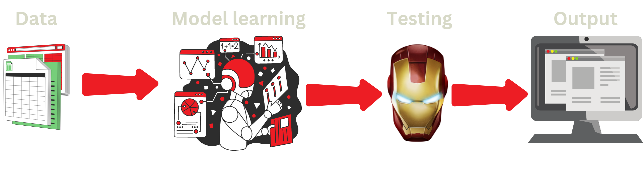
How ML works?
Pre-requisites
Knowledge of Python, numpy and pandas
Pre-requisites for workshop
pip install pandas
pip install numpy
pip install sklearn
Day-1
Marvel Series

Slide 5
How ML works?
Day-1
Marvel Series

Slide 6

How ML is different?
Day-1
Marvel Series

Slide 7


How ML is different?
Data
Output
Program
Data
Program
Output
Model
Day-1
Marvel Series

Slide 8



Characteristics of ML
Potential to perform automated data visualization
Precise data analysis
Intelligence at its finest
Day-1
Marvel Series

Slide 9

Advantage / Disadvantage of ML
That's Surprising, Right??
Day-1
Marvel Series

Slide 10



Advantage / Disadvantage of ML
Resolve complex problems
Data Acquisition
Automation of everything
Highly error -prone
Trends and patterns identification
Algorithm Selection
Wide range of applications
Time Consuming
Day-1
Marvel Series

Slide 11
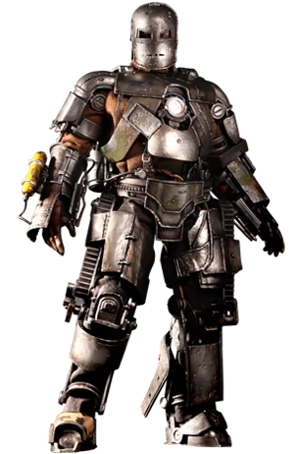
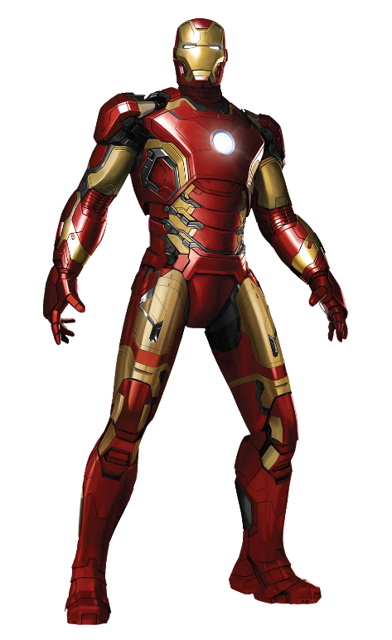
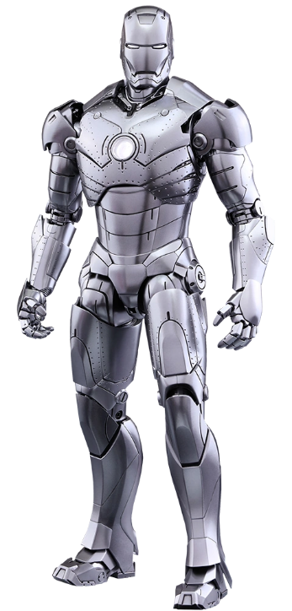
AI vs ML vs DL
[https://medium.com/@iamkhalil2005/difference-between-artificial-intelligence-vs-machine-learning-vs-deep-learning-407fe1a8853a]
Day-1
Marvel Series

Slide 12

Dataset
Ordinal Data
Numeric Data
(Quantitative)
Day-1
Marvel Series
Categorical Data
(Qualitative)

Slide 13
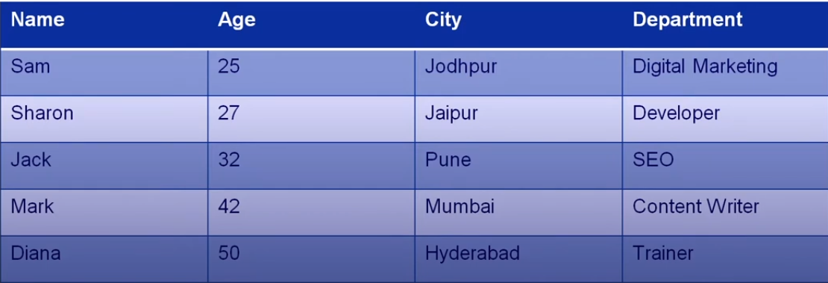
Dataset
Collection of records usually in tabular form.
Ordinal Data
Numeric Data
(Quantitative)
Day-1
Marvel Series
Categorical Data
(Qualitative)

Slide 14

ML Algorithms
Training Dataset
Training Dataset
(Validation Sets)
Dataset
Prediction Model
Numeric Data
(Quantitative)
Categorical Data
(Qualitative)
Ordinal Data
Day-1
Marvel Series
Testing Dataset

Slide 15
Kaggle Datasets
Amazon Datasets
UCI ML Repo Datasets
Google’s Data
Microsoft Datasets
Dataset
Training Dataset
ML Algorithms
Prediction Model
Training Dataset
(Validation Sets)
Testing Dataset
Day-1
Marvel Series
Awesome Public Dataset Repo
Scikit learn Dataset
Computer Vision Dataset
Government Dataset

Slide 16
Training Dataset
Training Dataset
(Validation Sets)
ML Algorithms
Dataset Resources
Kaggle Datasets
Awesome Public Dataset Repo
Amazon Datasets
Scikit learn Dataset
UCI ML Repo Datasets
Computer Vision Dataset
Google’s Data
Testing Dataset
Microsoft Datasets
Government Dataset
Day-1
Marvel Series
Prediction Model

Slide 17
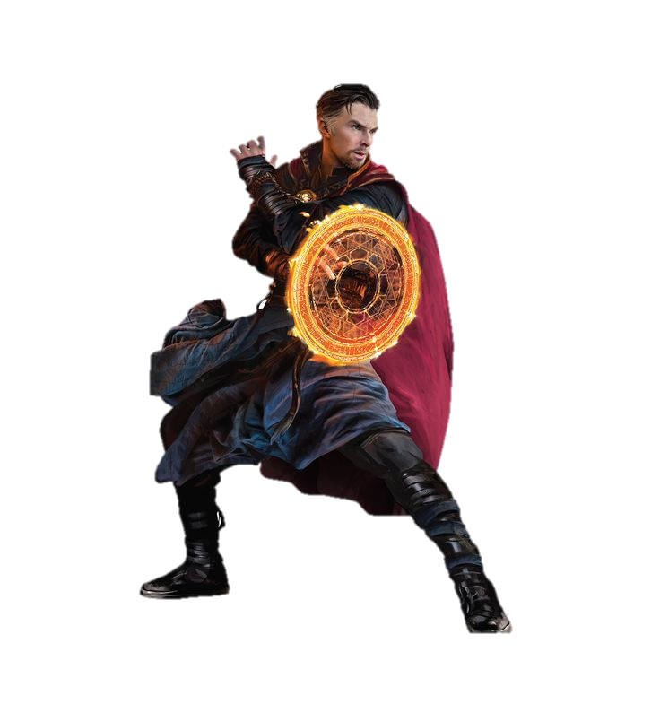
Awesome Public Dataset Repo
Scikit learn Dataset
Computer Vision Dataset
Government Dataset
Dataset Resources
Day-1
Marvel Series
Kaggle Datasets
Amazon Datasets
UCI ML Repo Datasets
Google’s Data
Microsoft Datasets

Slide 18
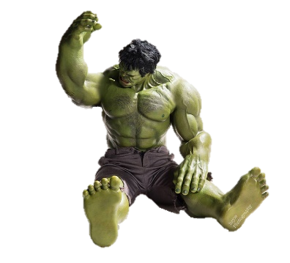
Government Dataset
Dataset Resources
Kaggle: https://Kaggle.com
Amazon: https:// registry.opendata.aws
UCI Repo: https://archieve.ics.ui.edu/ml/index.php
Microsoft: https://msropendata.com
Awesome Repo: https://github.com/awesomedata/awesome-public-datasets
Scikit learn: https://scikit-learn.org/stable/
Computer Vision : https://www.visualdata.io/discovery
Day-1
Marvel Series
Google’s Data

Slide 19

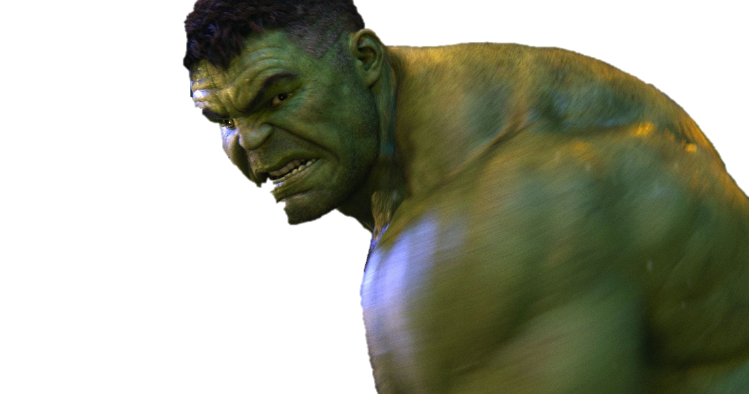
Kaggle: https://Kaggle.com
Amazon: https:// registry.opendata.aws
UCI Repo: https://archieve.ics.ui.edu/ml/index.php
Microsoft: https://msropendata.com
Government Dataset
Workshop Time
Let’s Code
Let’s Go
Data Pre-Processing
Day-1
Marvel Series
Awesome Repo: https://github.com/awesomedata/awesome-public-datasets
Scikit learn: https://scikit-learn.org/stable/
Computer Vision : https://www.visualdata.io/discovery
Google’s Data

Slide 20

Kaggle: https://Kaggle.com
Amazon: https:// registry.opendata.aws
UCI Repo: https://archieve.ics.ui.edu/ml/index.php
Microsoft: https://msropendata.com
Government Dataset
Any kuestions?
Day-1
Marvel Series
Awesome Repo: https://github.com/awesomedata/awesome-public-datasets
Scikit learn: https://scikit-learn.org/stable/
Computer Vision : https://www.visualdata.io/discovery
Google’s Data

Slide 21

Kaggle: https://Kaggle.com
Amazon: https:// registry.opendata.aws
UCI Repo: https://archieve.ics.ui.edu/ml/index.php
Microsoft: https://msropendata.com
Government Dataset
Thank You💙
Day-1
Marvel Series
Awesome Repo: https://github.com/awesomedata/awesome-public-datasets
Scikit learn: https://scikit-learn.org/stable/
Computer Vision : https://www.visualdata.io/discovery
Google’s Data

